Slide 1

“Serving up Ag Education” Project
A fun, different option for class finals or projects that allows students the flexibility to choose.
Main Course:
Choose 1
Sides:
Choose 2
Dessert:
Choose 1
Drink:
Choose 1
This is a great way to allow students a choice in their projects. You can set up the editable templates to fit your project and your class or use the premade guides!
Created for you: Bethany Prenger
Notes:
Hands-on

Slide 2
Menu Final Project
Purpose
This is a great project guide that will allow students options when completing a project and it shows them the importance of Agriculture Education. As a student works through the Menu it will give them options for a main dish, side dish, dessert, and drink. The menu board on the student menu project guide will inform the students of how many of each dish they must choice when they place their order. Each student will place their order with the teacher. The order sheet will be the grading rubric and will be handed back to the student as a check. Just like in a restaurant when you check out!
Includes
Student Menu Project Guide (Editable to fit your class and project needs)
Teacher Guide
3 Menu Templates
Place Your Order Grading Guide (filled out by the student)
Place Your Order Grading Guide (filled out by the teacher)
Editable Place Your Order Grading Guide
Premade sets of Student Menu Guides
Pre-made Daily Menu Survey (to gauge student progress)
Pre-made Weekly Menu Survey
Editable Menu Survey
Examples of the Project
Student Project Guide is created in PowerPoint therefore you can add a text box and create it to fit your project and student needs. In the example it shows the menu choices on the menu board. This is done by inserting a text box and writing on the board. You can also use the pre-made one if that works best for your class.
Menu Templates are created in PowerPoint and allow you to edit them as well. All you have to do is add a textbox with your project information.
Notes:
Change the purpose,

Slide 3
Menu Final Project Teacher Guide
Before the Project
Decide what project options you wish your students to choose from and add the information onto the menu templates.
Choose one of the options for your student guides.
Make copies of menu, student guide, and place your order grading guide for each student
During Project
Pass out the menu and the student guide to the students.
Students will select what projects they would like to complete off the menu.
They will then “place their order” with the you. You will write down their project selection on their place their order form. Or you can pass this form out and have the students write down their order on the form and bring it to you. ( I like to have the students place their order with me because I can then check to make sure they have selected the correct number of projects and if they have any questions I can answer them)
Students will start working on their projects.
At the end of each day or week you can have the students fill out a menu survey (exit slip) This allows you to follow their progress and give them points based on their work if you choose to.
Once the project is complete the students will turn it all in. Once you grade the project you will return their order form to them with their grade on it.
Notes:
Change the purpose,

Slide 4
Class Final Project
Name:____________________________________________Date:____________________
Class/Hour:_________________________________________________________________
Welcome to the “Serving Up Ag Education” Restaurant! Today you will be choosing projects from the attached menu. Below on the menu board is how many selections of each course you must choose. Follow the steps below to complete the activity.
Select projects based on the menu board below. The attached menu is labeled with the specific courses.
Once you have selected the correct amount of projects you would like to complete place your “order.”
Start working on your projects!
Throughout the project you will be asked to fill out a menu survey, like an exit slip. This will be used to give you participation points throughout the project. Therefore make sure you work hard each and every day!
Good Luck and enjoy!
Main Course:
Choose 1
Sides:
Choose 2
Dessert:
Choose 1
Drink:
Choose 1

Slide 5
Menu Project
Name:____________________________________________Date:____________________
Class/Hour:_________________________________________________________________
Welcome to the “Serving Up Ag Education” Restaurant! Today you will be choosing projects from the attached menu. Below on the menu board is how many selections of each course you must choose. Follow the steps below to complete the activity.
Select projects based on the menu board below. The attached menu is labeled with the specific courses.
Once you have selected the correct amount of projects you would like to complete place your “order.”
Start working on your projects!
Throughout the project you will be asked to fill out a menu survey, like an exit slip. This will be used to give you participation points throughout the project. Therefore make sure you work hard each and every day!
Good Luck and enjoy!
Main Course:
Choose 1
Sides:
Choose 2
Dessert: (Optional)
Choose 1
Drink:
Choose 1

Slide 6
Place Your Order Here!
Name:___________________________________________ Date:____________________________
Directions: Once you have selected the correct number of menu items fill out the form below and turn it in before you start your project.
Guest Check Name:_____________________________________________________________
Item | Description | $ (Points Given)
Main Dish
Side Dish
Dessert
Drink
Total
Notes:
Make one that students fill out and make one that a teacher fills out and make one that a teacher can edit

Slide 7
Place Your Order Here!
Name:___________________________________________ Date:____________________________
Guest Check Name:___________________________________________
Item | Description | $ (Points Given)
Main Dish
Side Dish
Dessert
Drink
Total

Slide 8
Place Your Order Here!
Name:___________________________________________ Date:____________________________
Guest Check Name:___________________________________________
Item | Description | $ (Points Given)

Slide 9
Daily Menu Survey
Name:_____________________________________________________Date:___________________
Class/hour:________________________________________________________________________
Directions: Answer the question below to the best of your ability.
Give yourself a letter grade for how well you think you worked today and explain why you gave yourself that grade.
What did you accomplish today? Explain below.
What will you work on tomorrow?
What do you have left to do on your project?

Slide 10
Weekly Menu Survey
Name:_____________________________________________________Date:___________________
Class/hour:________________________________________________________________________
Directions: Answer the question below to the best of your ability.
Give yourself a letter grade for how well you think you worked this week and explain why you gave yourself that grade.
What did you accomplish this week? Explain below.
What will you work on next week?
What do you have left to do on your project?

Slide 11
“Serving up Agriculture Education”
Name:____________________________________________Date:____________________
Class/Hour:________________________________________________________________
Due Date:__________________________________________________________________
Welcome to “Serving Up Agriculture Education” Restaurant! Today you will be choosing projects from the attached menu. Below on the menu board is how many of each course you must choose. This will be your final for the class. Follow the steps below to complete the activity.
Select projects based on the menu board below. The attached menu is labeled with the specific courses.
Once you have selected the correct amount of projects you would like to complete place your “order.”
Start working on your projects.!
Throughout the project you will be asked to fill out a menu survey, like an exit slip. This will be used to give you participation points throughout the project. Therefore make sure you work hard each and every day!
Good Luck and enjoy!
Main Course:
Choose 1
Sides:
Choose 2
Dessert: (Optional)
Choose 1
Drink:
Choose 1

Slide 12
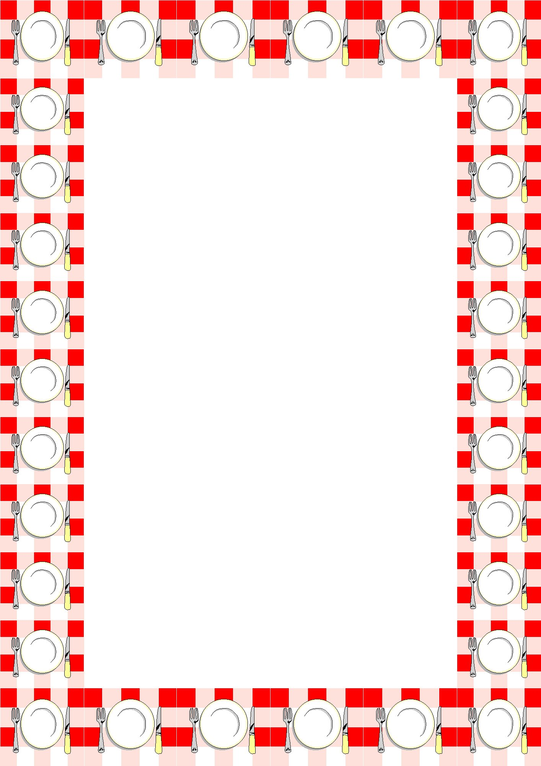
“Serving Up Ag Education” Project
Main Course
30 points Create a 10 page child's story book that talks about why agriculture education is important and what Ag. Each page must have at least three sentences and a picture on it. The topic must be approved first.
Topic:_________________________
30 Points Create a poster that explains why agriculture education as a career rocks! The pictures must have written explanations. It must include five pictures and 7 facts for each picture.
Topic:_________________________
30 Points Write a one page paper explaining how your Ag Teacher impacted your life. It must be 500 words.
Topic:___________________________
Sides
15 Points Interview an Ag Teacher or Student Teacher and figure out what they love about their job!
15 Points Created a poem that includes 10 lines about why you think agriculture education is important.
15 Points Create a song with at least 10 lines that includes information about Agriculture Education.
Desserts
10 Points Explain why agriculture is important and how it relates to your life. It must be five sentences.
Drink
10 Points: Find out more about Ag Education! Include schooling, salary, and job requirements. It should be 8-10 sentences

Slide 13
Credits for clipart:
Menu with plates
http://www.google.com/imgres?imgurl=http%3A%2F%2Fwww.clipartbest.com%2Fcliparts%2F9c4%2Fegp%2F9c4egpegi.jpeg&imgrefurl=http%3A%2F%2Fwww.clipartbest.com%2Fmenu-borders&h=2000&w=1414&tbnid=h6g2w8FAwL6xlM%3A&zoom=1&q=menu%20borders&docid=9_dUtLMWNIcl0M&ei=QkM1VO6JFoivyASl0oKoDA&tbm=isch&ved=0CC4QMygPMA8&iact=rc&uact=3&dur=1213&page=1&start=0&ndsp=36&surl=1&safe=active
black border
http://www.google.com/imgres?imgurl=http%3A%2F%2Fwww.clipartbest.com%2Fcliparts%2Fdir%2FkM5%2FdirkM59i9.jpeg&imgrefurl=http%3A%2F%2Fwww.clipartbest.com%2Ffree-menu-borders&h=4112&w=2493&tbnid=aY4CR9kIeG_LrM%3A&zoom=1&q=menu%20borders&docid=53O2_rPnh0hkIM&ei=QkM1VO6JFoivyASl0oKoDA&tbm=isch&ved=0CEoQMyghMCE&iact=rc&uact=3&dur=981&page=1&start=0&ndsp=36&surl=1&safe=active
Thanksgiving menu
http://www.google.com/imgres?imgurl=http%3A%2F%2Fwww.craftbuds.com%2Fwp-content%2Fuploads%2F2011%2F11%2FMenu3.jpg&imgrefurl=http%3A%2F%2Fwww.craftbuds.com%2Fthanksgiving-place-setting-printables%2F&h=2304&w=1411&tbnid=0_OxivhogAIbEM%3A&zoom=1&q=menu%20borders&docid=JqEsim1rvnfYNM&ei=QkM1VO6JFoivyASl0oKoDA&tbm=isch&ved=0CEsQMygiMCI&iact=rc&uact=3&dur=464&page=1&start=0&ndsp=36&surl=1&safe=active
Chef Holding Board
http://www.google.com/imgres?imgurl=http%3A%2F%2Fwww.myfreephotoshop.com%2Fwp-content%2Fuploads%2F2013%2F12%2F128.jpg&imgrefurl=http%3A%2F%2Fwww.myfreephotoshop.com%2Fcartoon-chef-holding-a-menu-vector-material.html&h=946&w=600&tbnid=yTyZxrYTVTay3M%3A&zoom=1&q=chef%20holding%20a%20menu&docid=rm3uShdHYhg0eM&ei=bmI1VKuCPJScygSO14L4BA&tbm=isch&ved=0CCEQMygFMAU&iact=rc&uact=3&dur=423&page=1&start=0&ndsp=33&surl=1&safe=active

